Slide 1
Biomass Combined Heat and Power
Student’s name
Institutional Affiliation
Course
Date

Slide 2
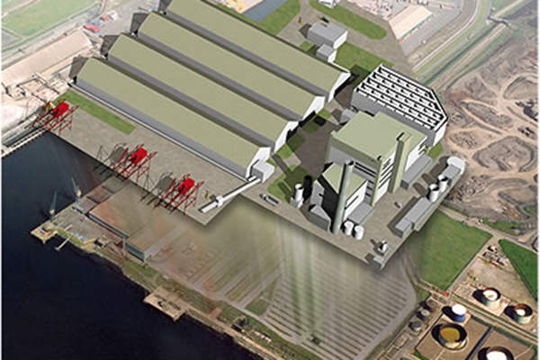
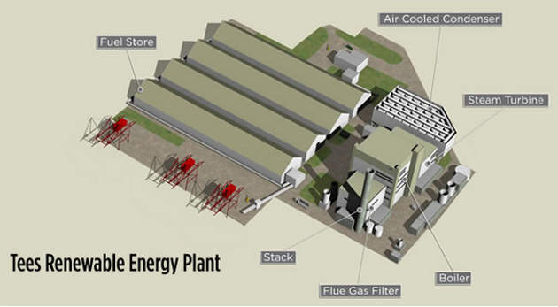
History
Images of Teesside Biomass Combined Heat and Power project
The biggest Biomass Combined Heat and Power project is found in the United Kingdom at a place called Teesside.
The project was initiated because it is more efficient
The project has a capacity of producing 299 megawatts of steam and electricity
Notes:
The biggest Biomass Combined Heat and Power project is found in the United Kingdom at a place called Teesside.
The project was initiated because it is more efficient (75 to 80 percent efficient) than the traditional plants that used fossil fuel that was 50 percent efficient [6].
The project has a capacity of producing 299 megawatts of steam and electricity making it the world's largest Biomass Combined Heat and Power .Another largest Biomass Combined Heat and Power project is the Finnish energy firm .
Fortum which is able to keep a five day of demand of fuel for 1.4 million households in Stockholm city.
The Canadian National Research Council is trying to work with other stakeholders to build training and testing Biomass Combined Heat and Power at the university of British Columbia campus, Vancouver [7].

Slide 3
Introduction
Biomass Combined Heat and Power (Biomass CHP) is one of the important technologies for many sites.
It helps many sites when they are off the main gas grid
It makes the CHP the fastest contributor type of power source and it is good system in dependability whenever more energy is required and urgently needed.
It is faced with regulatory, political and economic barriers.
Notes:
Biomass Combined Heat and Power (Biomass CHP) is one of the important technologies for many sites.
It helps many sites that constantly demand electricity and heat more particularly, when the sites are off the main gas grid and where there is the availability of biomass fuel.
The process of building CHP is much quicker comparing to the traditional central power plants.
It makes the CHP the fastest contributor type of power source and it is good system in dependability whenever more energy is required and urgently needed

Slide 4
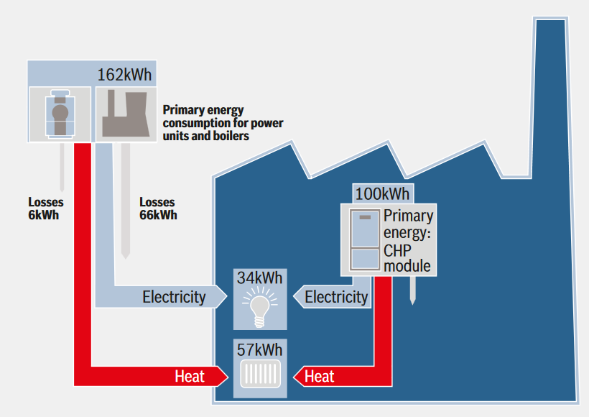
Application of CHP
The use of biomass is an alternative to the widely used electrical heating in many countries.
Biomass Combined heat and power (CHP) contribute several benefits.
It is designed with the aim of providing both electricity and heat from a single heat source [1].
An Image showing Production of electricity by Biomass Combined Heat and Power
Notes:
The use of biomass is an alternative to the widely used electrical heating in many countries.
Biomass Combined heat and power (CHP) contribute several benefits to the communities, individuals, companies including regional and national users by replacing the standard power generation that can assist the economic, environmental, and energy.
By definition, Biomass Combined Heat and Power is a system that is designed with the aim of providing both electricity and heat from a single heat source [1].

Slide 5
Advantages_1
This research report provides the benefits
The combustion produces a lot of heat
Heat produced is used for the production of steam for power generation
Notes:
The combustion produces a lot of heat which is further used either directly or in the production of steam for power generation or industrial processes.
Biomass Combined Heat and Power is also known as co-generation plants. This research report provides the benefits, challenges, and barriers that Biomass Combined Heat and Power face.
Additionally, the report will provide information on the world’s largest Biomass Combined Heat and Power and its advanced systems as well as its applicability and popularity in Canada.

Slide 6
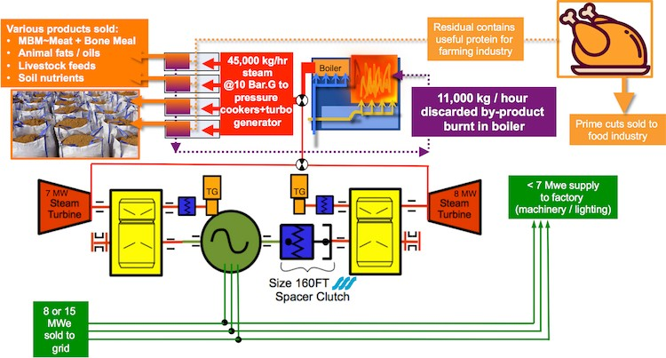
Advantages_2
It provide heat for the steam cycles.
The heat produced is transferred to the district heating system.
It mitigates high energy price problems.
Biomass Combined Heat and Power plant boilers providing heat for the steam cycles
Notes:
Biomass Combined Heat and Power plant boilers provide heat for the steam cycles which further generate electricity from the generators linked to steam turbines.
The heat from these processes is further transferred to the district heating system. Heat is extracted from the system using any means.
For instance, Heat is extracted by steam turbine extraction, by directly extracting heat directly from the boilers or by using a back-pressure steam turbine.
There are various benefits that accrue to the use of Biomass Combined Heat and Power.
It mitigates high energy price problems. Biomass Combined Heat and Power reduces the prices of energy by increasing the efficiency by triple or twice the efficiency of normal fuel use [2].

Slide 7
Advantages _3
It takes part in the reduction of harmful substance emission.
It also increases the reliability of electro systems.
It is capable of eliminating breakdown possibilities that are witnessed in the distribution systems.
Biomass CHP ensures autonomous supply of energy.
help in competing with conventional suppliers of energy.
Notes:
It takes part in the reduction of harmful substance emission. Any energy transformation causes pollution.
In a similar way it mitigates the prices, Biomass Combined Heat and Power reduces emissions by using three or two times less fuel. It also increases the reliability of electro
systems.
The current electro system’s reliability is low and the breakdown of the system causes high economic damage more so in the systems that are highly computerized. Biomass Combined Heat and Power is capable of eliminating breakdown possibilities that are witnessed in the distribution systems. Biomass CHP ensures autonomous supply of energy.
Many firms have monopolized the energy market. In this context, many stakeholders opt for biomass CHP projects so as to compete with conventional suppliers of energy.

Slide 8
Advantages_4
It reduces the burden of electro-distributing grid capacity.
The technology exposes latest electricity production.
Biomass CHP impacts the environment positively.
Has environmental benefits
mitigates the dependency of diversification of energy, imported on imported fossil dependency and rural development.
The prices of Biomass fuel are always stable
Notes:
Biomass Combined Heat and Power reduces the burden of electro-distributing grid capacity. The technology exposes latest electricity production that mitigates the need for new investment for electricity production units, distribution networks and also the reduction of the losses associated with electricity distribution. Biomass CHP impacts the environment positively. Larger power plants have a significant consequence on the surrounding environment. Environmental benefits like the reduction of emissions of greenhouse gas, acid rain reduction, as well as soil improvements reduce health risks that may affect the humans.
Politically, the Biomass Combined Heat and Power mitigates the dependency of diversification of energy, imported on imported fossil dependency and rural development. The prices of Biomass fuel are always stable in the market and it is not affected by global or national energy markets. Biomass is not subjected to global monopolistic control [3].

Slide 9
Disadvantages_1
It is affected by the regulation, financial, and political interest
It is labor-intensive and expensive in terms of capital investment.
faces a challenges are associated with the Spark Spread.
Notes:
There are a number of challenges that face the Biomass Combined Heat and Power both locally and internationally.
Event though the CHP has many benefits, still there are some significant obstacles to the larger distribution that has not been solved and required attention.
These obstacles includes the regulation, financial, and political interest of different countries mainly the top energy consumer and producer regions.
The projects associated with Biomass Combined Heat and Power is labor-intensive and expensive when considering the required capital investment. Basically, Biomass Combined Heat and Power projects are of different sizes and shapes. An average cost of capital starts from 700 U.S dollars to 3,000 U.S dollars for a single kilowatt.
This translates to an extraordinary investment [4]. Another challenge that Biomass Combined Heat and Power faces

Slide 10
Disadvantage_2
Unfavourable spark spread is a potential barriers to the deployment of Biomass Combined Heat and Power.
The spark spread not varies across industries and countries. The payback period for the Combined Heat and Power is very long.
Long payback for the project
Notes:
Unfavourable spark spread in local markets normally is viewed as potential barriers to the deployment of Biomass Combined Heat and Power.
Spark spread is that difference existing between the costs of fuel needed in powering the system of Combined Heat and Power and the costs associated with the grid-provided power and heat to a plant if the system of Combined Heat and Power had not been installed.
The spark spread not varies across industries and countries.
The payback period for the Combined Heat and Power is very long.
The payback period is the time a project takes to cover the capital that was used to install the project. The Biomass Combined Heat and Power project's.
payback period is projected to be ranging from about 2 years to about 12 years where 4 years to 6 years represents the range that is most typical [5].
This means that those managers and stakeholders who may wish to initiate a project that has a shorter payback period may find it challenging to consider Biomass Combined Heat and Power.

Slide 11
Conclusion
a wide range of technologies has been tested and proved to be viable as alternative energy generators.
Many countries have become environmentally conscious thus requiring the Biomass Combined Heat and Power to replace the conventional energy production that polluted the environment.
Biomass Combined Heat and Power is not only generated energy but also produces heat that is used in factories.
The United Kingdom is championing the move by initiating the largest Biomass Combined Heat and Power in the world.
Notes:
In conclusion, a wide range of technologies has been tested and proved to be viable as alternative energy generators.
Many countries have become environmentally conscious thus requiring the Biomass Combined Heat and Power to replace the conventional energy production that polluted the environment.
Biomass Combined Heat and Power is not only generated energy but also produces heat that is used in factories.
The United Kingdom is championing the move by initiating the largest Biomass Combined Heat and Power in the world.

Slide 12
References_1
[1] EME 807 Technologies for Sustainability Systems, (n. d). 8.6. Bio-mass Fueled Combined Heat and Power Systems. PennState. Retrieved from; https://www.e-education.psu.edu/eme807/node/714
[2]. P, Collings, (2012). Can Biomass Combined Heat and Power and a District Heat Network be a viable energy service for a small town in rural Ireland? Institute of Energy and Sustainable Development, Leicester. Retrieved from; https://www.dmu.ac.uk/documents/technology-documents/research/iesd/dissertations/2015/pcollings-msc-diss-can-biomass-chp.pdf
[3]. S, Wickwire, (2007). Biomass Combined Heat and Power Catalog of Technologies. U. S. Environmental Protection Agency. Retrieved from; https://www.epa.gov/sites/production/files/2015 07/documents/biomass_combined_heat_and_power_catalog_of_technologies_v.1.1.pdf

Slide 13
References_2
[4] Power Webinar, (2016). One of the World’s Biggest Biomass-Fired CHP Plants Is Inaugurated. Retrieved from; https://www.powermag.com/one-worlds-biggest-biomass-fired-chp-plants-inaugurated/
[5]. A Kaufman, and A, Chittum, (2011). Challenges Facing Combined Heat and Power Today: A State-by-State Assessment. Report Number IE111. Retrieved from; https://www.energy.gov/sites/prod/files/2013/11/f4/ie111.pdf
[6]. Hanley, S. 2015. World’s Largest Biomass CHP Facility Going up in England. Solar Energy News and Commentary. Retrieved from; https://solarlove.org/worlds-largest-biomass- chp-facility-going-england/
[7]. National Research Council Canada, n. d. NRC building Canada’s first biomass CHP testing and training hub for remote communities. Canada. Retrieved from; https://www.nrccnrc.gc.ca/eng/publications/nrc_pubs/bioenergy/2017/winter_main_article.html

